Slide 1
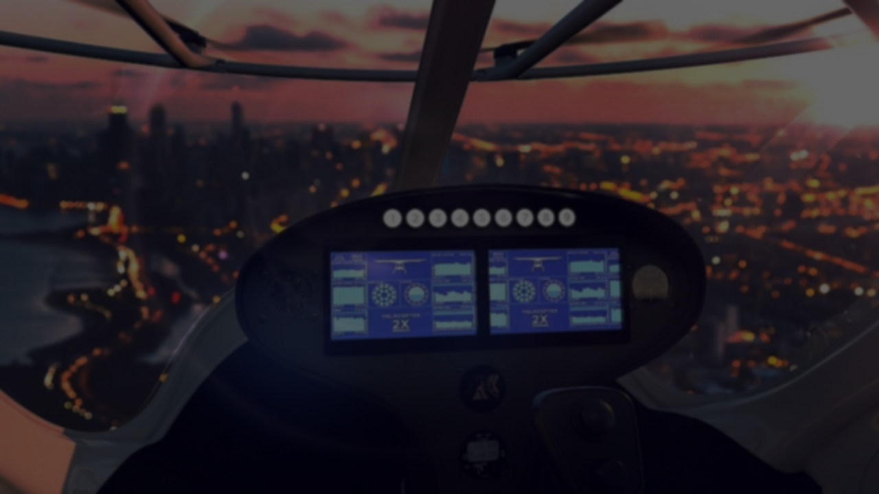


Towards single pilot operations:
A review of cockpit interaction concepts
Arijit Gupta
15.11.2019
Notes:
Introduce yourself
Name the topic
- I did not have access to resources (focus group, real pilots, laboratory environment etc) to create an interaction concept. Hence this article is more of a literature review of current standards and probable visions for the future

Slide 2
Introduction
What is Single Pilot Operation?
Currently, a two pilot system is common for large wide-body aircrafts
The potential of a future cockpit featuring only one pilot
Interest from NASA, airline companies and aircraft manufacturers
2 of 18
Notes:
What? – the potential of a future cockpit featuring only one pilot
There is an interest from NASA, airline companies and aircraft manufacturers
Sullenberger landed alone on Hudson
Embraer is designing aircraft for the 2020 – 2025 timeframe

Slide 3
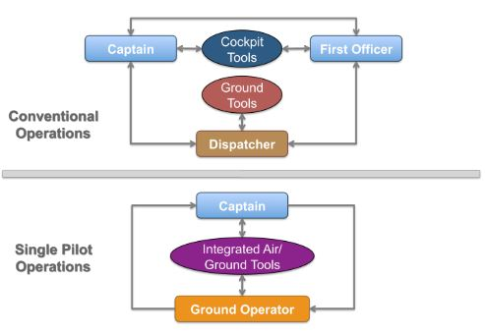
Introduction
What is Single Pilot Operation?
Karl D. Bilimoria, Walter W. Johnson, and Paul C. Schutte. 2014. Conceptual framework for single pilot operations. HCI-Aero 2014
3 of 18
Notes:
Having only one pilot in the cockpit

Slide 4
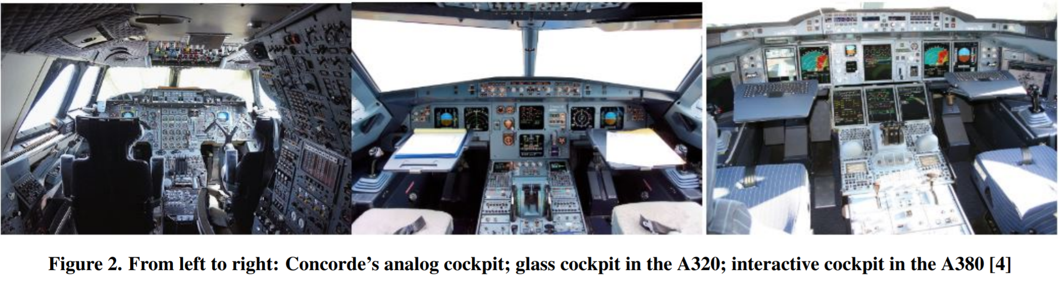
Introduction
In What context?
Commercial
Wide Body
Long-haul
Nadine Couture, Nadine Couture, The Aircraft of the Future : Towards the Tangible Cockpit. Proceedings HCI-Aero ’16 (2016)
4 of 18
Notes:
What context? – scope is too broad in terms of aircraft type, short/long-haul flights, private/commercial carriers etc.

Slide 5
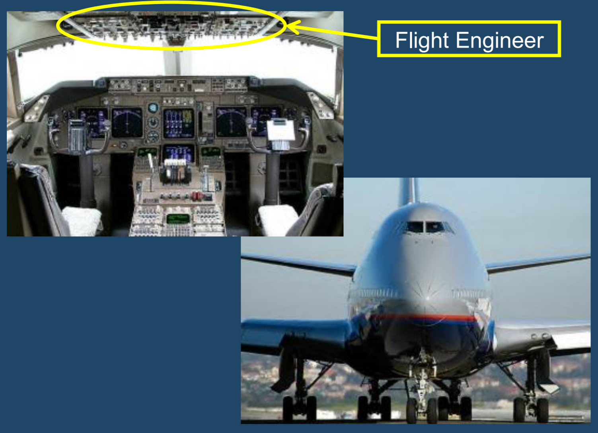
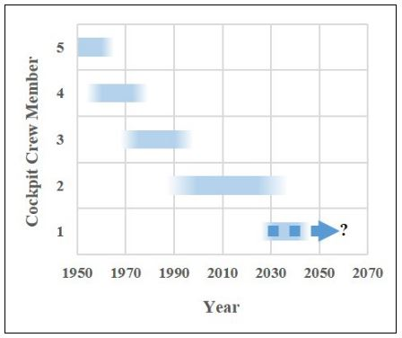
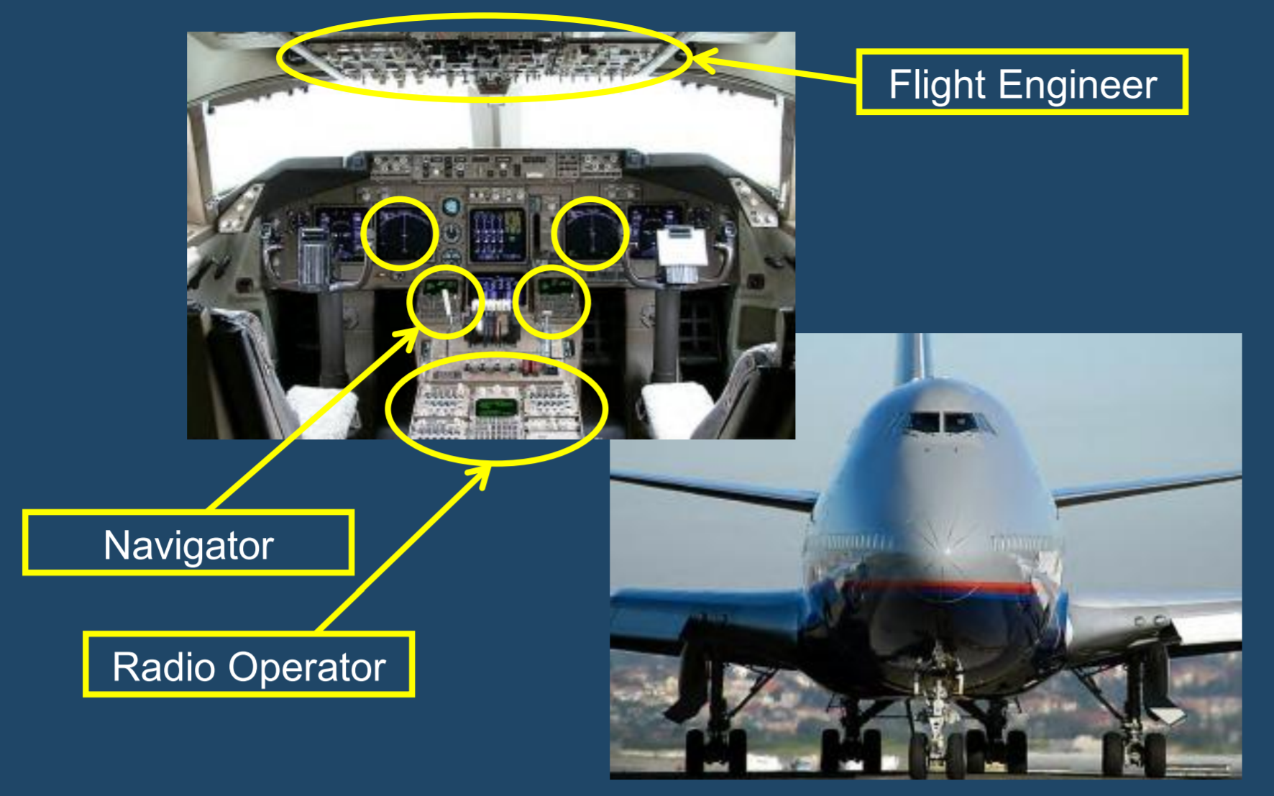
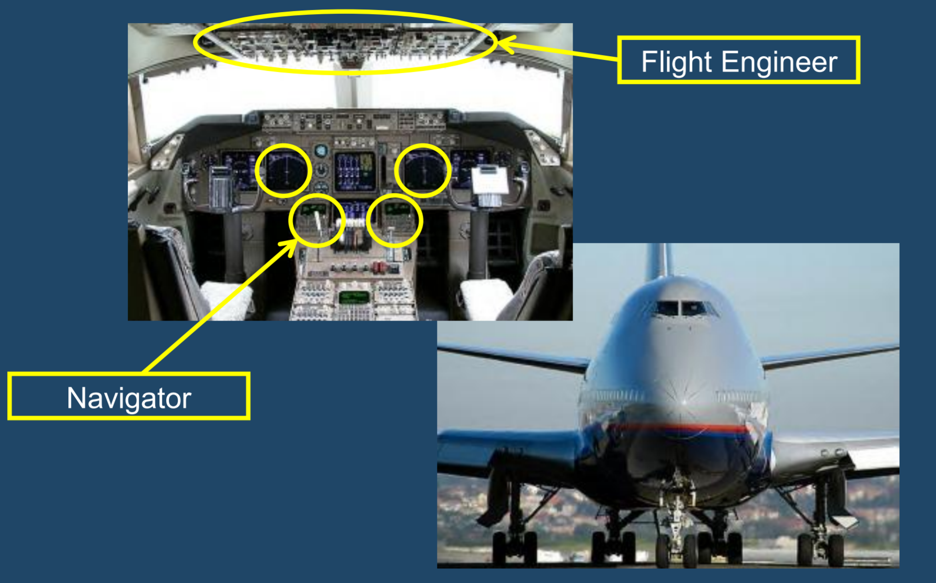
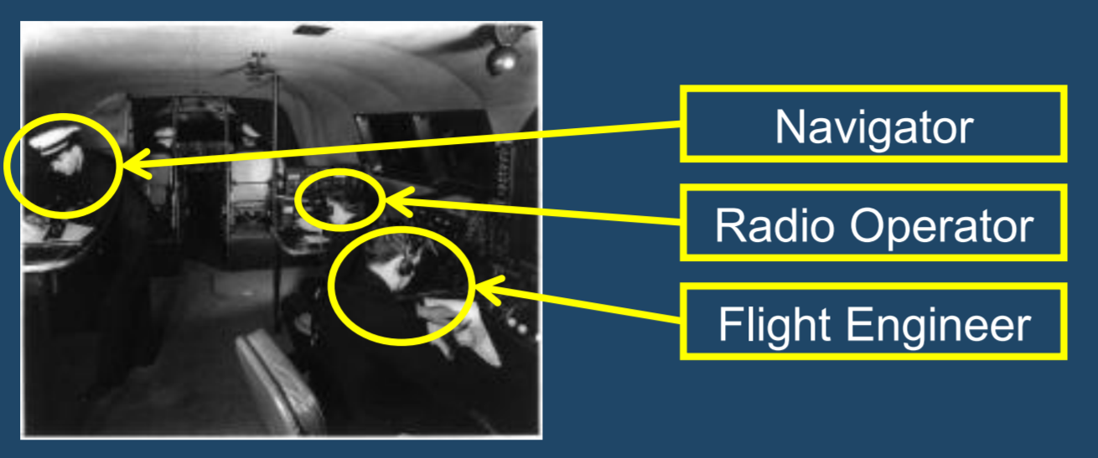
A little history
of “de-crewing” in the cockpit
1950s
1970s
1980s
2019
Captain, First Officer, Flight Engineer,
Navigator, Radio Operator
Captain, First Officer
Crew size of four
Crew size of three
Don Harris, Neville A. Stanton, and Alison Starr. 2015. Spot the difference: Operational event sequence diagrams as a formal method for work allocation in the development of single-pilot operations for commercial aircraft. Ergonomics 58, 11 (nov 2015),
5 of 18

Slide 6
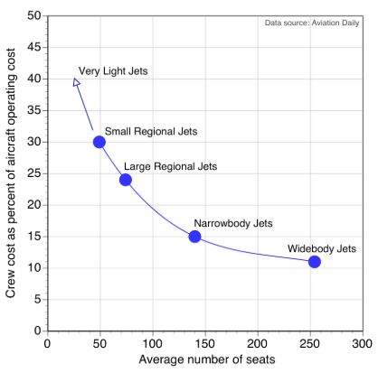
Motivation
for Single Pilot Operations
Cost of on board flight personnel represents the highest percentage (typically 10-15%) of operating cost of an aircraft
The reduction of a single cockpit member could further save up to 50 % cost in salary cost in salary with additional savings on licensing, training etc.
SPOs might provide a solution to the global pilot shortage and increase flexibility in crew scheduling
The Tran, Ferdinand Behrend, Niels Funning, and Andres Arango. 2018. Single Pilot Operations with AR-Glasses using Microsoft HoloLens
6 of 18
Notes:
If SPO were ultimately adopted, the cost per passenger or per mile would decrease. Therefore, ticket prices would decrease.

Slide 7
Single Pilot Operations
Two potential paths
Ground-Based Support: In the future we will be relying much more extensively on air-ground collaboration, with many of the First Officer functions being handled remotely
Flight Deck Automation: In the future we will have a flight deck with very intelligent automation that can effectively replace the functions of the First Officer
7 of 18
Notes:
any functions currently performed by the first officer can be absorbed by an air-ground based approach or an automation-centric approach

Slide 8
Ground-Based Support
Today’s cockpits are based on a two-pilot safety critical system
An air-ground approach is thought of as an improved version of air traffic control that is able to serve multiple aircrafts
Common issues with this approach are lack of awareness between two pilots, missing non verbal cues and pilots’ general subjective dislike.
Joel Lachter, Sarah V. Ligda, Summer L. Brandt, Michael Matessa, Vernol Battiste, and Walter W. Johnson. 2014b. Toward single pilot operations: Developing a ground station. In HCI-Aero 2014
8 of 18
Notes:
Modern aircrafts are able to take-off, cruise and even auto land without major intervention from pilots.
One might ask, what is the need of two pilots.
The pilots’ presence in the cockpit is necessary for monitoring and in case of an emergency, to take over control. The need for safety is paramount and redundancy is necessary. While autonomy in flights have decreased pilot’s physical workload, cognitive workload has increased over the years
According to Lachter et al. [7] a two pilot crew, separated in flight and ground, is a feasible solution

Slide 9
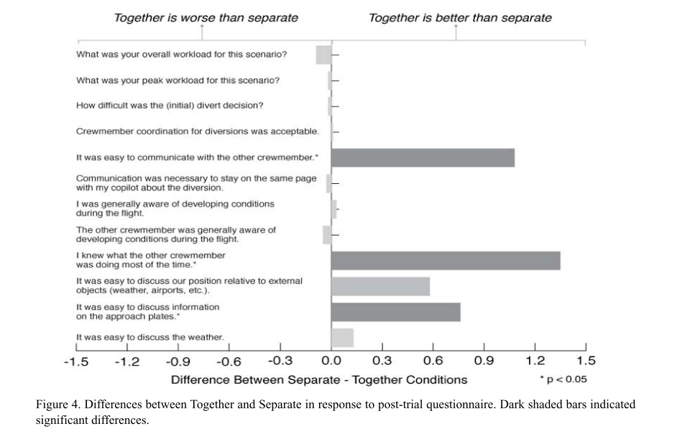
Ground-Based Support
Joel Lachter, Quang V. Dao, Vernol Battiste, Robert Koteskey, Michael Matessa, and Walter W. Johnson. 2014a. Toward single pilot operations: The impact of the loss of non-verbal communication on the flight deck. In HCI-Aero 2014
9 of 18

Slide 10
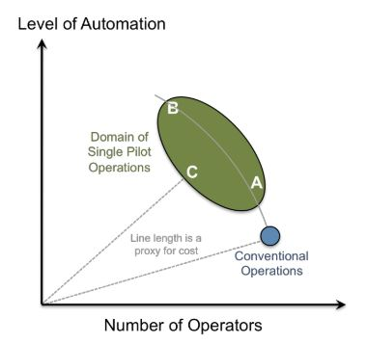
Flight Deck Automation
In the automation-centric approach, a single pilot can fly the aircraft without receiving aid of a second human operator
Human interaction with automation has both benefits and pitfalls. Automation can reduce physical workload but increase cognitive workload, leading to problems associated with vigilance or complacency
Common issues with this approach are lack of awareness between two pilots, missing non verbal cues and pilots’ general subjective dislike.
Kim Phuong L. Vu, Joel Lachter, Vernol Battiste, and Thomas Z. Strybel. 2018. Single Pilot Operations in Domestic Commercial Aviation. Human Factors 60, 6 (sep 2018)
10 of 18
Notes:
Specifically, in terms of flight deck automation, he asked the audience to consider a future flight deck with very intelligent automation that can effectively replace the functions of the first officer. Furthermore, he reminded the audience that, in the future, we will be relying more extensively on air-ground collaboration. Therefore, he asked the audience to imagine a case in which many of the first officer functions are handled remotely (from the ground). He reminded the audience that these two potential paths to SPO are not necessarily exclusive, and they do not necessarily represent an exhaustive list of possibilities

Slide 11
Human-Autonomy Teaming (HAT)
Shively et al. highlighted the notion of human-autonomy teaming (HAT), where humans and automation work together
HAT marks a significant shift from the notion that automation simply replace human functions
Human understanding of automation’s intent and reasoning as well as automation’s understanding of human preferences, attitudes and states is crucial for HAT.
R. Shively, Joel Lachter, Summer Brandt, Michael Matessa, Vernol Battiste, and Walter Johnson. 2018. Why Human-Autonomy Teaming?
11 of 18

Slide 12
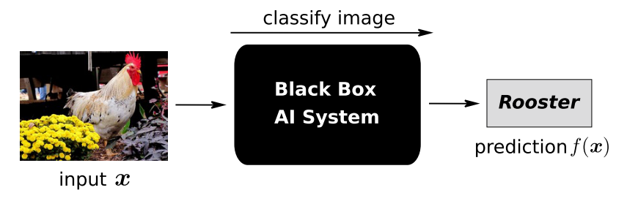
Explainable AI
In recent years, performance of AI based systems have exceeded human level for not only simplistic but complex tasks (e.g. sentiment analysis, speech understanding or strategic game playing)
Highly optimized AI models usually work in a black box manner. This has been a concern for number of application areas (e.g. medicine, law, self-driving cars)
There is a need of explainable and human interpretable AI for trust building.
12 of 18
Notes:
Why explainability ?
Verify predictions
Identify flaws and biases
Learn about the problem
Ensure compliance to legislation

Slide 13
Cockpit Design
Two potential concepts
Tangible cockpit: identify criteria and properties within the cockpit’s user interfaces that can facilitate the coexistence between its tactile and physical actuators.
Augmented Reality: to discover how an AR-device can be integrated on board the human-machine system and to define the pilot-cockpit interaction, to improve the overall performance of the SPO if ground support is not possible
13 of 18

Slide 14
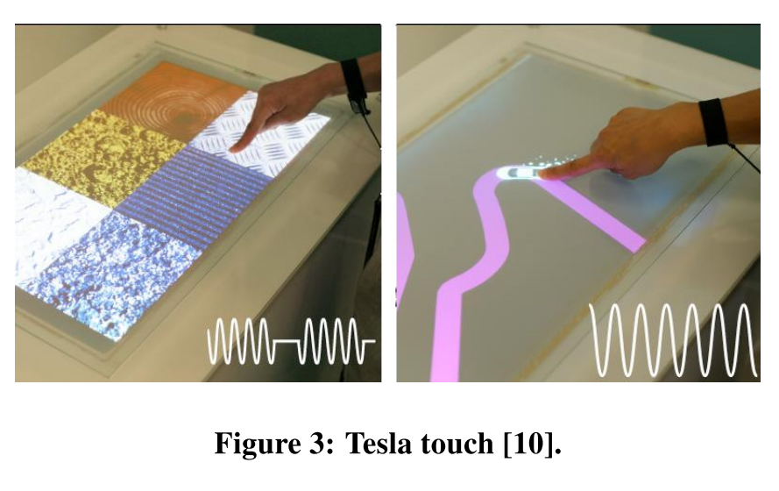
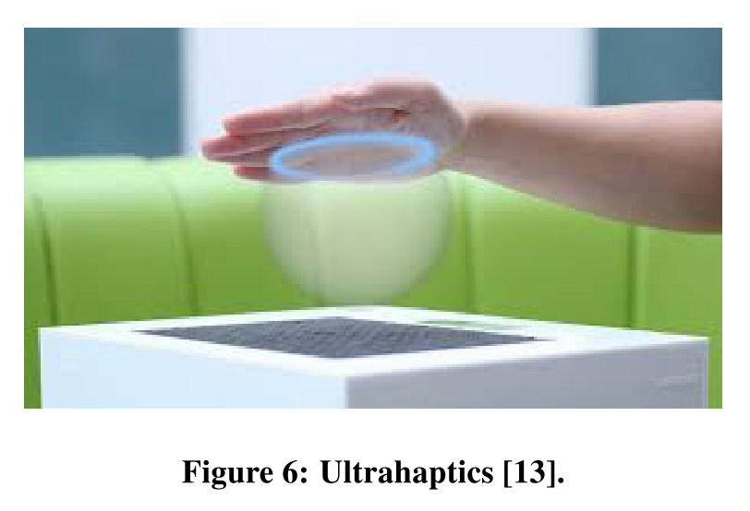
Cockpit Design
Tangible cockpit
Input equals output: The display is also the input device. The same continuous surface that provides information to the pilots will be used to introduce commands and control the aircraft.
Function equals Form: The shape of the display equals its function. Applied to the cockpit, it means that the shapes of its devices afford their function.
Form follows flow: The display can take different shapes. Triggered by events like the context or the flight stage, sections of the cockpit will be capable of showing up or modifying their shape to adapt accordingly
Nadine Couture, Nadine Couture, The Aircraft of the Future : Towards the Tangible Cockpit. Proceedings HCI-Aero ’16 (2016)
14 of 18

Slide 15
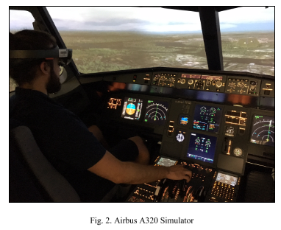
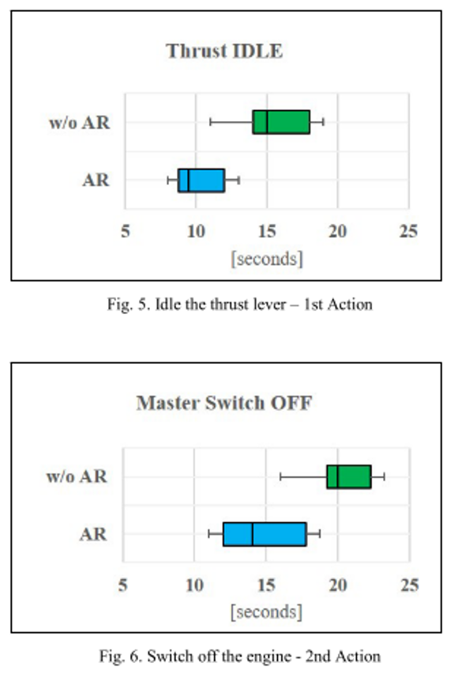
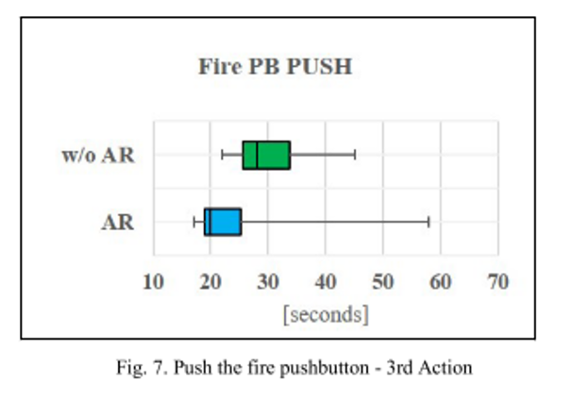
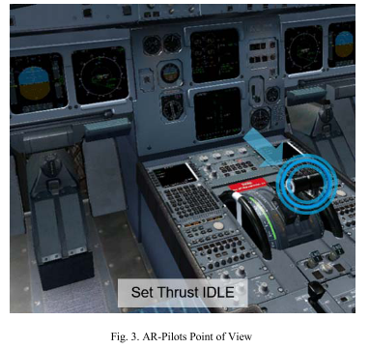
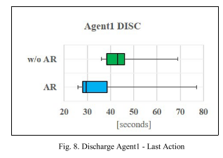
Cockpit Design
AR Glasses
The Tran, Ferdinand Behrend, Niels Funning, and Andres Arango. 2018. Single Pilot Operations with AR-Glasses using Microsoft HoloLens
15 of 18
Notes:
operation environment during cruise flight. For the survey, 24 experienced and type rated active Airbus A320 pilots have been compared in two groups to each other using an Airbus A320 fix based simulator.
commercial pilots of German airlines and are divided into two groups of 12 people each

Slide 16
Barriers to SPO
Barriers:
Perceived and actual reduction in safety
Increased pilot workload
Reduced ability to handle off-nominal events
New Requirements:
Smarter advanced automation
Improved coordination/collaboration
– With both remote people and automation
16 of 18

Slide 17
Arguments against SPO
Unacceptable to flying public?
Too much faith in automation and communication reliability?
Won’t save money, just moves people to the ground?
17 of 18

Slide 18
Conclusion
A single pilot operation would mean less cost to employ pilots, less time spent on training and there is definitely an interest from the aviation industry
However, major hurdles exist in terms of technology (automation, connectivity, communication security), regulations (certifications on an aircraft) and social acceptance of SPO
Lack of trust in automation and AI based system is also a major issue and hence transparency through the use of explainable AI models is proposed
Pilots, passengers and all stakeholders must be kept in the loop at all stages to realize the vision of cockpit of the future for a single pilot operation
18 of 18

